Slide 1
Corrective Action Report
By Responsible Party
Model
Part Name
NC Item
NC Ratio
Responsibility
Repeated Case | No / Yes : Remark if Yes
Initial Detection * | Market Warranty / High Line NC% / Audit Findings / Inspection NC / Vendor @ Production Feedback
CAR No.
*Please circle one of the following options
Prepared by
Approved by
(Management/ Dept Head)
Issue Date :
Reply Due Date :
Date
Date
QCXX-CARX-09-021224-01

Slide 2
Summary
By Responsible Party
Model & Part Name
NC Description
COPQ (If any)
 | Root Cause | Countermeasure
Occurrence
Outflow
Damage Escalation (If any)

Slide 3
D1) Define Team
By Responsible Party
Form your team. Get the specialist involved.
No | Name | Dept | Designation
1
2
3
4
5
6
7

Slide 4
D2) Define Problem : Observation
By Responsible Party
Describe the abnormality/common point from return sample if any
AC Sample
NC Sample

Slide 5
D2) Define Problem : Process Flow
By Responsible Party
List down the flow to identify potential NC occurrence & leak out
NC Leak
①
NC Occurrence①

Slide 6
D2) Define Problem : NC Reproduction
By Responsible Party
Reproduce the NC to identify the Root Cause. This will be the input for 5 why if hypothesis=reproduction.

Slide 7
D2) Define Problem : 5 Gen in 5M+1E
By Responsible Party
List down all the potential possibilities by brainstorming. Take 5Gen and compared to the rule(PCP, Drawing, WI etc). Eliminate possibilities after actual confirmation.
Focus :
5M+1E | What Possibility? | Judgement | Why judge so?
Man
Machine
Material
Method
Measurement
Environment
Refer following slides for evidence collects through 5 gen → Gemba現地 – The Actual Place (Go there), Gembutsu現物 – The Object (Examine it), Genjitsu現実 – The Actual Fact (Collect it), Genri原理 – The Principle (Discover it), Gensoku原則 – The Standard (Implement it)

Slide 8
D3) Containment Action
By Responsible Party
Sorting Out Result
Decision :
Keep Monitoring / Stop Production / Stop Shipment / Stop Production & Stop Shipment
*Please circle one of the following options
*Attach Rework Manual in Appendix if any

Slide 9
D4) Root Cause Analysis : Occurrence
By Responsible PIC
Occurrence Root Cause : Why NC happen? (Process Control)
Corrective Action
Corrective Action
Preventive Action
*Please elaborate at least in 2 tiers
*Actual root cause is highlighted in yellow for further action

Slide 10
D4) Root Cause Analysis : Detectability
By Responsible PIC
Detection Root Cause : Why cannot detect? (Detectability)
Corrective Action
Corrective Action
Preventive Action
*Please elaborate at least in 2 tiers
*Actual root cause is highlighted in yellow for further action

Slide 11
D4) Root Cause Analysis : QMS
By Responsible PIC
System Root Cause : Why cannot prevent problem? (Procedure, Control & System)
Corrective Action
Corrective Action
Preventive Action
*Please elaborate at least in 2 tiers
*Actual root cause is highlighted in yellow for further action

Slide 12
D5) Corrective Actions(For 5M+1E) Summary
By Responsible Party
Identify the short-term counter actions
Root Cause | Details of measures | Date of completion of measures | PIC

Slide 13
*Please duplicate the slide if action more than 1
D6) Corrective Actions(For 5M+1E)
By Responsible Party
Short term counter actions implementation
Before
After

Slide 14
D7) Preventive Actions Summary
By Responsible Party
Identify the long-term counter actions
Root Cause | Details of measuresorrective actions) | Date of completion of measures | PIC

Slide 15
*Please duplicate the slide if action more than 1
D7) Preventive Actions
By Responsible Party
Identify the Long-term counter actions
Before
After
15

Slide 16
D7) Prevent Recurrence
By Responsible Party
Prevent problem from recurring to similar system/ product.
No | Reflections | Verification
1 | Any other system/ product potentially affected
2 | If yes, what are the system/ product?
3 | If yes, do you extend the preventive action to other system/ product?
Remark:

Slide 17
Improvement Implementation Verification
By Reponsible Party
SCM will verify the action from this sheet. Verification shall involve specialist.
Fill by Responsible party |  |  |  | Fill by SCM QC
No | NC Items | Action | Date | Verification | Status
1
2
3
4
5
6
Verify by (SCM):
Approve by:
Date:
Date:

Slide 18
Effectiveness Verification
By SCM QC
Type | Date | Finding | Status
At “Type” column, Fill in “Audit” or “Lot Monitoring”
Evaluation:
Effective / Not Effective
*Please circle one of the following options
Verify by :
Approve by:
Delist Proposal:
Yes/ No
Date:
Date:
1
*Please circle one of the following options

Slide 19
APPENDIX
*Add Slide if there is any additional attachment/ documentation/ flow, etc

Slide 20
Root Cause Analysis Example 1
D2) Root Cause Analysis by 5 why Guideline
Get the NC factor from slide 8 after elimination of not potential factor
1st Why
Machine stopped working
It overheated.
Operator noticed an usual noise & stopped the machine
The cooling system failed
The coolant pump was not working
Component was loose
It was no properly secured during last maintenance
It was no receiving power
The fuse blew due to an electrical surge
Maintenance procedure was not followed correctly
Technician was not adequately trained
1st Why
NC Factor 1 (Machine)
NC Factor 2 (Man)
Why did the machine stop?
Why did the machine stop?
2nd Why
2nd Why
Why did it overheat?
Why was there an usual noise?
3rd Why
3rd Why
Corrective Action
Secure the loose component
Why did the cooling sys fail?
Why was the component loose?
4th Why
4th Why
Why was the coolant pump not working?
Why was it not properly secured?
5th Why
5th Why
Why was it not receiving power?
Preventive Action
Install a surge protector to prevent electrical surge.
Implement regular maintenance check on cooling system.
Why was the procedure not followed correctly?
Preventive Action
Provide additional training.
Review maintenance procedure
Corrective Action
Replace the blown fuse and restore power to the coolant

Slide 21
Root Cause Analysis Example 2
D2) Root Cause Analysis by 5 why Guideline
Get the NC factor from slide 8 after elimination of not potential factor
1st Why
Car won’t start
The battery is dead
The headlights were left on overnight
The automatic shut-off feature didn’t work
The sensor faulty
No replace new one even showing signs of wear
Driver forgot to turn them off
They were in a hurry
They were running late for appointment
Why won’t car start?
2nd Why
Corrective Action
Replace new battery
Why is the battery dead?
3rd Why
Why were the headlights left on overnight?
4th Why
Preventive Action
Set a reminder to check before leaving the car
4th Why
Why didn’t the automatic shut-off feature work?
Why didn’t the driver forget to turn them off?
5th Why
Corrective Action
Replace new sensor
5th Why
Why is the sensor faulty?
Why were they in a hurry?
Preventive Action
Regularly check and maintain car’s electrical system

Slide 22
D4) Root Cause Analysis Example 3
By Responsible PIC
Occurrence Root Cause : Why NC happen? (Process Control)
Burr
❷The operator has poor judgement skill(do not know how to differentiate AC/NC)
There is no limit sample on AC burr condition after deburring
The deburring process is not effective
❶The operator has poor deburring skill(don’t know target area)
There is no clear instruction in WI/PCP
The 2nd machining is not in ideal condition
❸The cutter is blunt
The cutter is used over tool life
The cutter purchase is not enough to cover production need
There is no good system to monitor cutter change
❹The feed rate is not follow MSPE original setting
Technician doesn’t know the feed rate setting
There is no SOP to mention 2nd machining setup
There is no procedure for MSPE to give SOP when transfer process
❺The cutting speed is not follow MSPE original setting
Operator accidentally adjust the manual knob(override) during 5S
Operator doesn’t know the knob function/importance
There is insufficient training/knowledge on the CNC machine for operator
There is no training content/evaluation on 2nd machining process
NC Factor 1
NC Factor 2
Get the NC factor from slide 8 after elimination of not potential factor
1st Why
Corrective Action
Lock the override in machine program
2nd Why
3rd Why
Corrective Action
Make SOP
Corrective Action
Make WI/PCP
Corrective Action
Make limit sample
Corrective Action
Make good cutter issuance record & SOP
4th Why
Preventive Action
Make rule when transfer process
Preventive Action
Set rule of all CNC machine must enable tool life counter
5th Why

Slide 23
Root Cause Analysis Example 4
D2) Root Cause Analysis by 5 why Guideline
Project cannot be done on time
There is not enough manpower
There are many unforeseen problems that results delayed
There is no SOP that guide the project flow
There is no proper plan at initial stage
There is not efficient in doing work
There are many personnel doing the same job
The job scope is not clear
There is no OC and job scope set in the early of project stage
There is no SOP to state the project flow
There is no competent personnel to perform the job
There is not enough training
There is no risk management
There is no SOP that guide the project flow
There is no system to monitor the manpower competency
Get the NC factor from slide 8 after elimination of not potential factor
NC Factor 1
NC Factor 2
1st Why
2nd Why
Corrective Action
Do Risk Management
3rd Why
Corrective Action
Provide Training
Preventive Action
Do SOP to serve as guideline for new project
4th Why
Preventive Action
Do new system to monitor manpower skill & training
Corrective Action
Make clear the job scope
5th Why
Corrective Action
Make clear the job scope

Slide 24
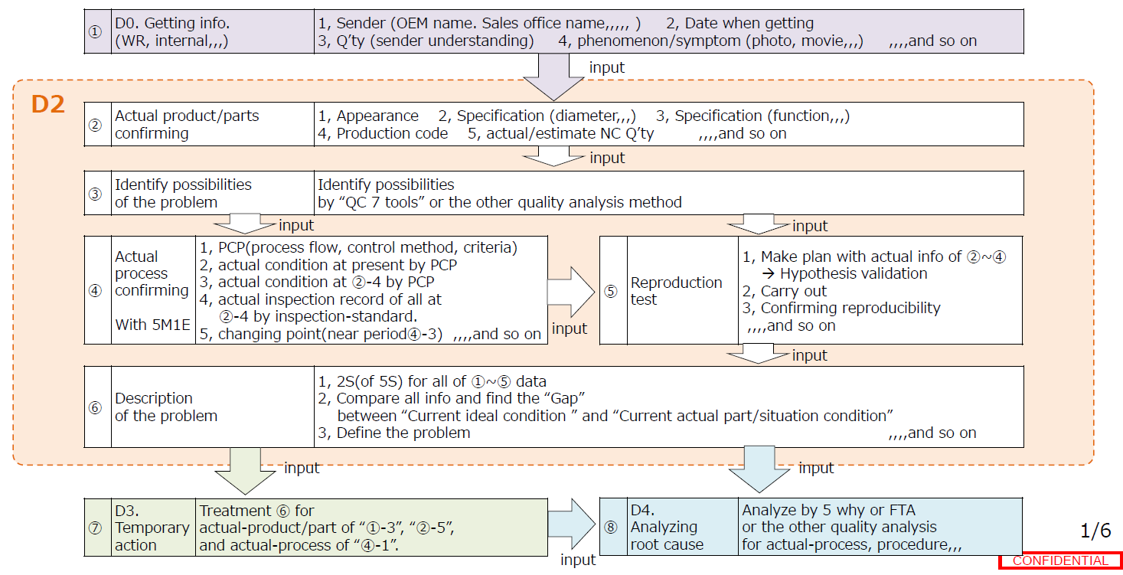
Root Cause Analysis
D2 Guideline

